Slide 1

Classes for Ops
Transitioning To Dev
Irwin Strachan
@irwinstrachan

Slide 2



Thank You To Our Sponsors

Slide 3

About_Irwin
Blogging pshirwin.wordpress.com
GitHub irwins
Twitter @irwinstrachan
Contributor community.idera.com/powershell
Notes:
If you’re looking for me online you can find me at one of these hangouts

Slide 4
Agenda
Classes new to PowerShell v5
The basic stuff
What we did before classes (code)
What we can do with classes (more code)
Takeaway/Comments
Notes:
So What's on the agenda today
Classes new to PowerShell v5
The basic stuff (Not too much)
Breakdown classes with a simple class
What we did before classes (code)
What we can do with classes (more code)
Let's keep it interactive, I hope I can answer any question you ask if not… Well we can always get the community involved!
Alright! Let 's get Started!

Slide 5
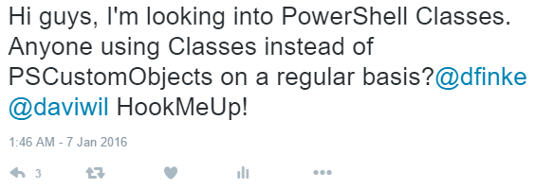
Classes new to PowerShell v5
Notes:
I remember the first time I got introduced to PowerShell classes was a presentation Ben Gelens did on writing DSC Resources using classes.
I remember thinking to myself, just for DSC Resources? Surely something as awesome as classes deserves more exposure… So I got on Twitter…
Who hasn't heard of Doug Finke? ImportExcel? Doug is a developer, a MVP and all-around great guy!
I love the fact that the PowerShell community is quite nurturing! Doug broke it down for me!
Doug is my hero and makes me want to be a better coder!

Slide 6

Classes new to PowerShell v5
Notes:
So fun fact, at the last PSConfEu I was chatting about classes with a full-fledge .Net developer… I guess I should have noticed the smile on his face…
I even tweet about it… Me talking Classes with a .NET developer is like a scrawny guy talking about his sick gainz to a Bodybuilder… #StayHumble

Slide 7
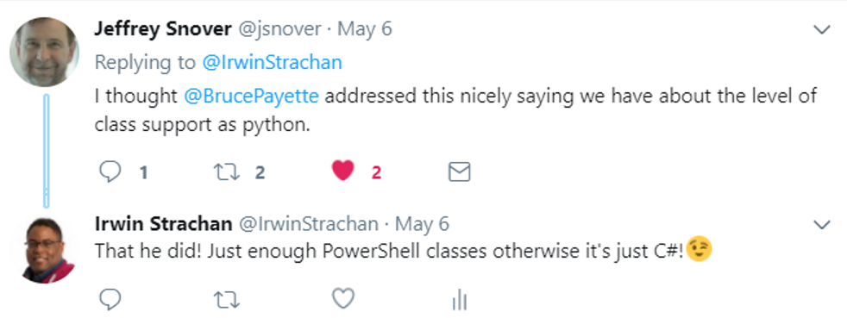
Classes new to PowerShell v5
Notes:
I made a memo to myself (must look into Python)

Slide 8
Classes new to PowerShell v5
Get-Help about_Classes
Supported scenario we’re discussing:
Define custom types in Windows PowerShell by using familiar object-oriented programming constructs, such as classes, properties, methods, inheritance, etc.
Notes:
Well why not ask PowerShell?
Get-Help about_Classes
So the Long Description is:
LONG DESCRIPTION
Starting in Windows PowerShell 5.0, Windows PowerShell adds language
for defining classes and other user-defined types, by using formal syntax
and semantics that are similar to other object-oriented programming
languages. The goal is to enable developers and IT professionals to
embrace Windows PowerShell for a wider range of use cases, simplify
development of Windows PowerShell artifacts--such as Windows PowerShell
Desired State Configuration (DSC) resources--and accelerate coverage
of management surfaces.
Here are the Supported scenarios for classes:
SUPPORTED SCENARIOS
-- Define DSC resources and their associated types by using the
Windows PowerShell language.
-- Define custom types in Windows PowerShell by using familiar object-
oriented programming constructs, such as classes, properties, methods,
inheritance, etc.
-- Debug types by using the Windows PowerShell language.
-- Generate and handle exceptions by using formal mechanisms, and at the
right level.
Luc's Session covered the DSC Resources part. I'll be talking about custom types. Properties Methods etc etc.
Classes are like modules just instead of having a bunch of loose functions you can group them together and access them with the . (dot) operator.

Slide 9
The basic stuff
Class Structure
Classes
Properties
Methods
$this
Constructor

Slide 10
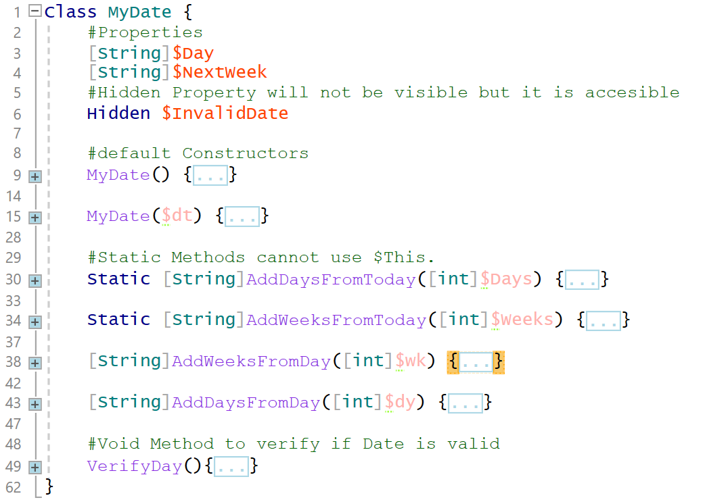
Breakdown classes with code
Notes:
Demo time code!

Slide 11
Demo transition code to a Class
The challenge here is to get the File size in KB,MB or GB
Each example will be an improvement over the other (Well at least it should be)
Example 1 Get File Size the Ops way
Example 2 Get File Size in Kb
Example 3 Get File Size in KB,MB and GB
Example 4 Use Add-Member. Get File Size in different formats using a script method
Example 5a Use a Filter to get FileSize
Example 5b Use a script method to figure out the correct format size
Example 6 Let's make a Class of this
Notes:
Demo FileSize Code

Slide 12
Take away
Why use Classes?
Everything is in one place
Intellisense
Better discovery
Bonus: Makes you feel more like a Developer ☺

Slide 13
Questions?

Slide 14

Thank You To Our Sponsors
Thank You To Our Post-Event
Drink Sponsors
Come and Join us for some drinks at the Red Lion after the event

